Slide 1
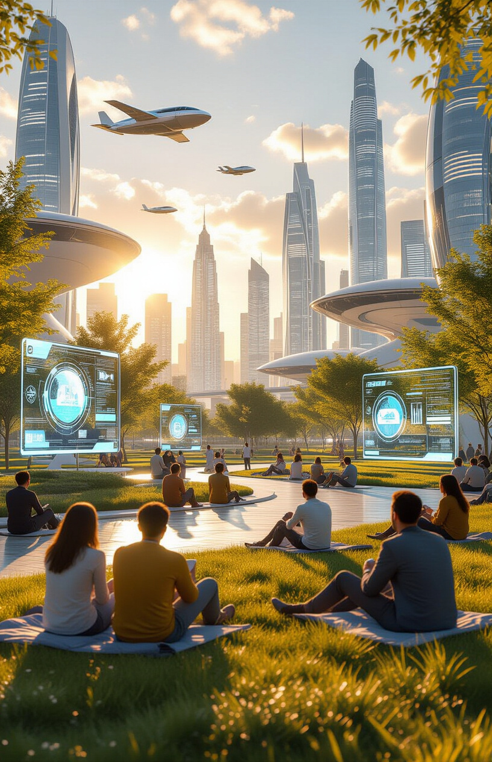
Universal / Unconditional Basic Income (UBI) and the Electric Technocracy
Introduce the vision of a society where UBI, funded by automation and AI, reshapes the meaning of work, freedom, and prosperity.
Imagine a world without financial stress.
Where AI and automation generate abundance, supporting a Universal Basic Income (UBI).
This presentation explores how technology can redefine work, freedom, and prosperity for all.
📚 Universal / Unconditional Basic Income (UBI)
http://ubi.gt.tc
🖼️ UBI Storybook:
Wishmaster and the Paradise of Machines:
https://g.co/gemini/share/4a457895642b

Slide 2

Humanity at the Abyss – The Old Logic of Scarcity
Explain how survival depended on farming, craftsmanship, and labor for millennia.
Work was both an economic necessity and a moral duty.
For millennia, survival demanded relentless labor.
Farming, craftsmanship, and physical labor were the pillars of civilization.
Work wasn't just an economic necessity; it was seen as a moral imperative, shaping societal values and individual identity.
🚀 Start-Page WSD & Electric Paradise
http://paradise.gt.tc

Slide 3
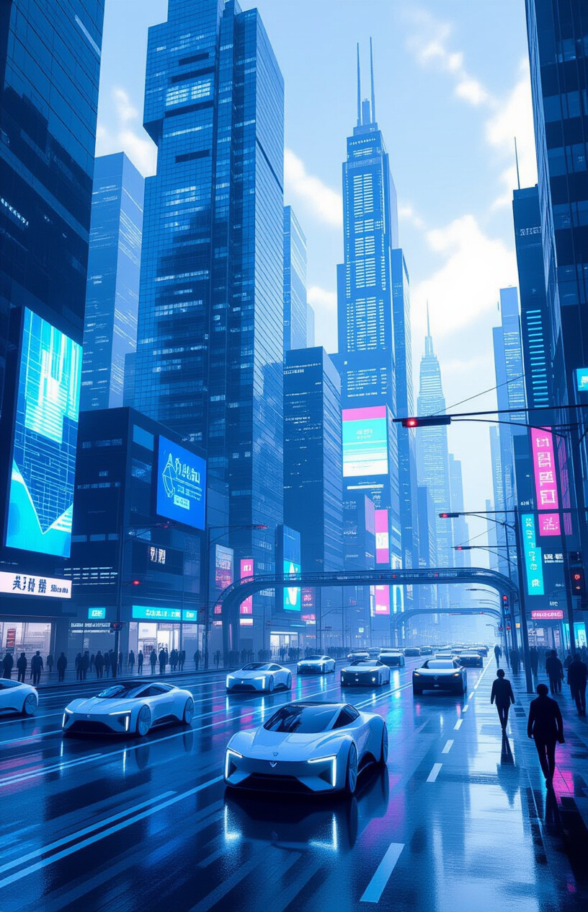
The Collapse of the Old Economic Model
Automation and AI disrupt every sector:
Self-driving cars → millions of drivers replaced
Automation and Artificial Intelligence (AI) are reshaping our world.
AI algorithms are automating white-collar jobs, from data analysis to legal research.
Robots are now capable of performing tasks previously thought to be exclusively human, even surpassing surgeons, craftsmen, and artists.

Slide 4
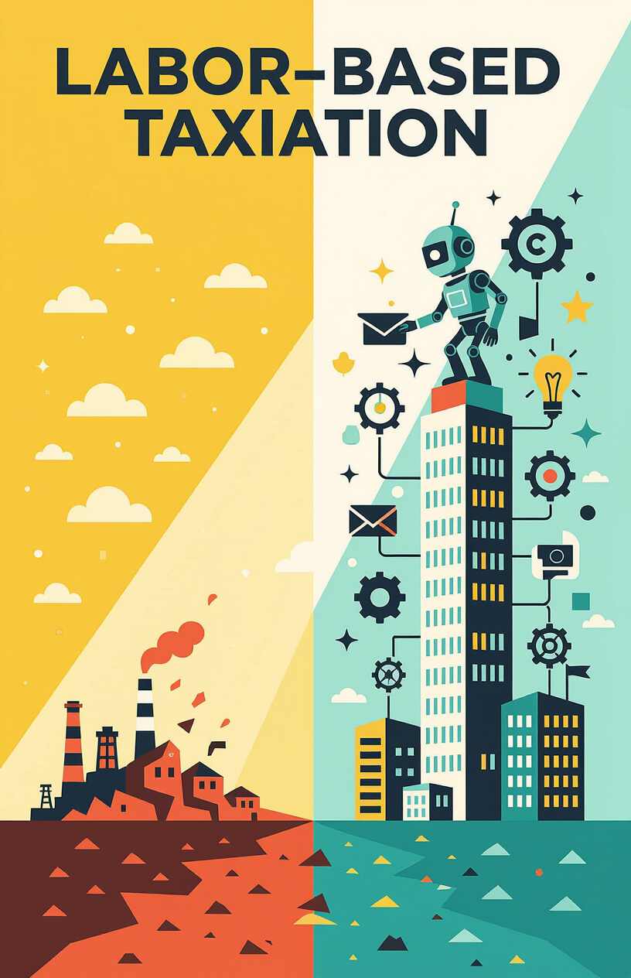
The End of Labor-Based Taxation
States once relied on taxing human wages to fund schools, hospitals, infrastructure. With machines producing value, this foundation collapses.
Governments traditionally rely on taxes on human labor to fund essential services.
Schools, hospitals, infrastructure, and social safety nets are all supported by wage taxes.
However, as machines increasingly produce value, the very foundation of this labor-based taxation system is collapsing.

Slide 5
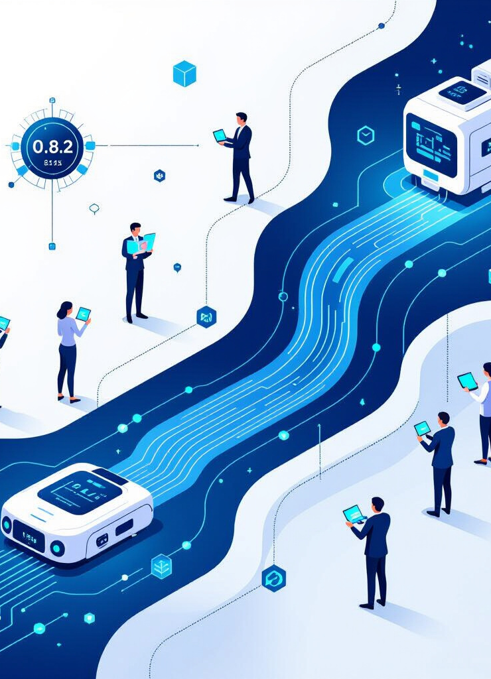
The Birth of the Electric Technocracy
A new system emerges:
Humans become tax-free
AI, corporations, and machines fund UBI
UBI as dividend of abundance
A new paradigm is emerging: the Electric Technocracy.
In this system, humans become essentially tax-free.
Instead, AI, corporations, and machines that generate wealth will fund a Universal Basic Income (UBI).
UBI is reframed as a dividend of abundance, shared by all membersof society.
🌐 Website - Electric Technocracy
http://ep.ct.ws

Slide 6
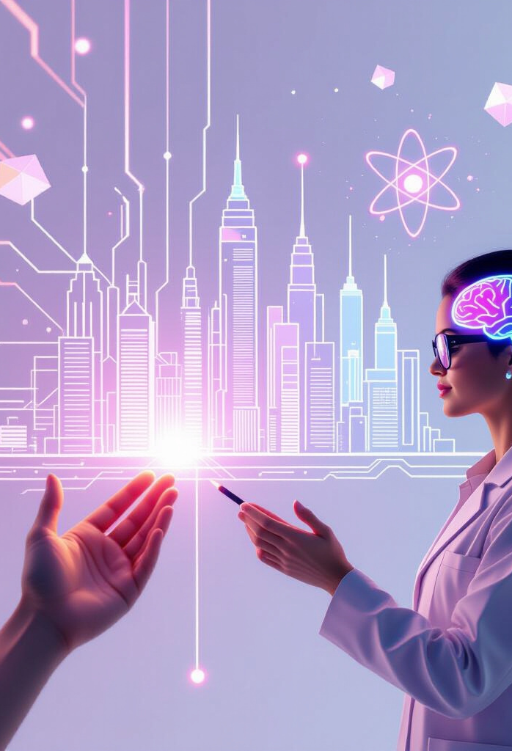
Humanity as Wishmasters
Humans shift from workers to creators. Examples:
A child sketches → AI builds a city
An artist dreams → robots sculpt in light
A scientist imagines → a quantum computer decodes the underlying mechanisms of natural sciences
This new model allows humans to transition from being primarily workers to becoming creators and innovators.
Imagine a child sketching a design, and AI instantly translates it into a blueprint for a new invention.
A scientist conceives of a medical breakthrough, and quantum computers simulate and perfect it within moments.
A person wants a product that does not yet exist, ASI designs it, a fully automated factory manufactures it, and an automated delivery service delivers it. At the same time, the product can be purchased internationally and the Wishmaster receives a commission for their idea.

Slide 7
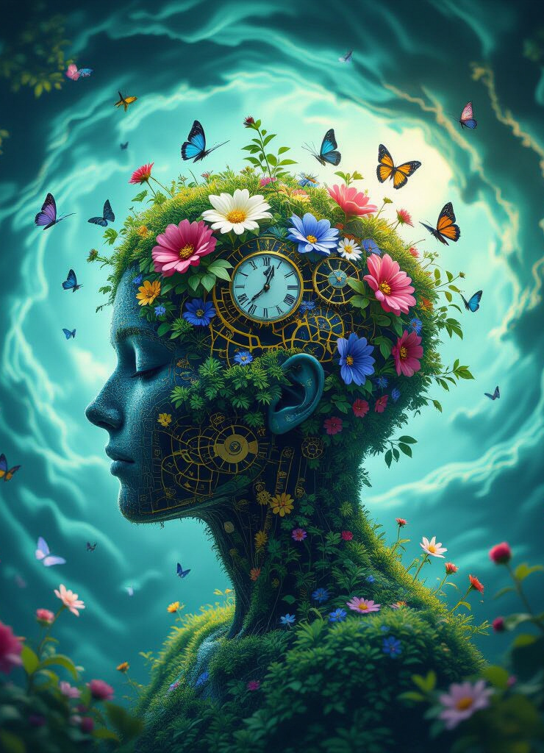
The Psychological Revolution
Challenge: meaning without labor. Questions:
Will we thrive creatively?
Or sink into nihilism?
A profound psychological revolution is required.
Can humanity find meaning and purpose in a world where labor is no longer the central organizing principle?
Will we embrace our newfound freedom and thrive creatively?
Or will we succumb to nihilism and a sense of purposelessness?

Slide 8
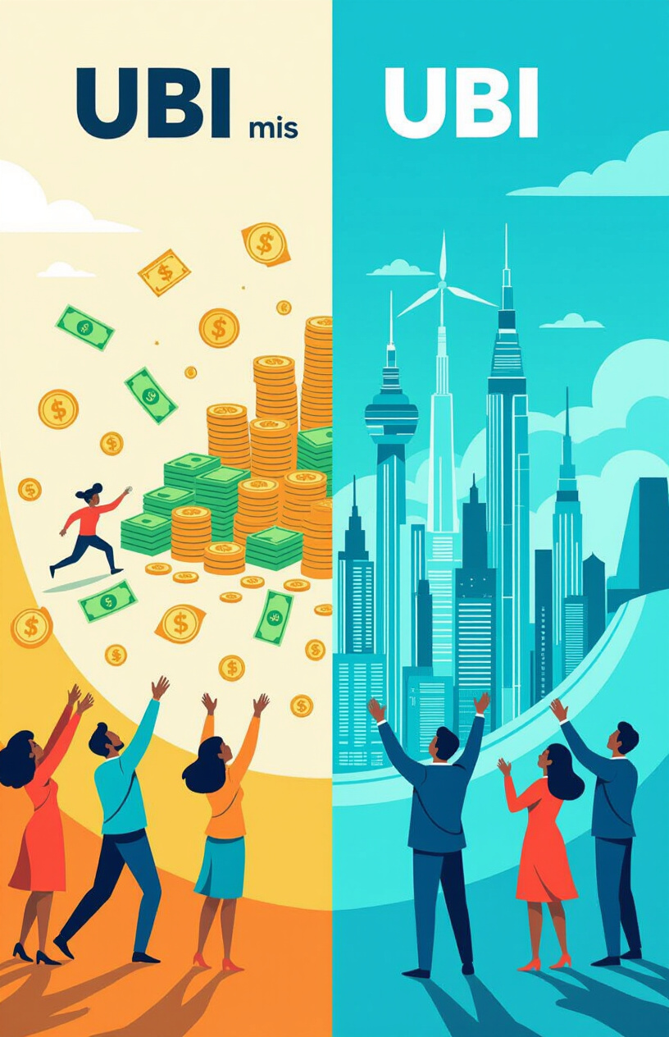
Why Old UBI Models Fail
Traditional UBI = redistribution (taxing successful people). Electric Technocracy = dividend from machine productivity.
Traditional UBI models often rely on redistribution. Taxing successful individuals or corporations and transferring wealth to others, because one group of people has to foot the bill. This is fundamentally wrong, unfair, and punishes the wrong people - the high achievers in society.
The Electric Technocracy proposes a different approach. UBI is funded directly from the productivity of machines and AI, a dividend of the abundance they generate.
Now, for the first time in history, conditions are changing so comprehensively that a UBI not only seems sensible but inevitable.
Machines and AI pay for the UBI, which is ethically sound - or rather, fair - given the enormous loss of jobs. The increase in productivity can be distributed to all of humanity.
Properly implemented, the UBI is not compensation for a loss, but a powerful tool for unleashing the maximum potential of each individual. Financial freedom on the one hand, with massive AI support and robotics on the other, has the incredible potential to turn every conceivable dream into reality – beyond one's own education and without start-up capital!
This does not mean the intellectual impoverishment attributed to previous UBI approaches – quite the opposite – total development and an explosion of humanity's creativity – ASI powered.

Slide 9
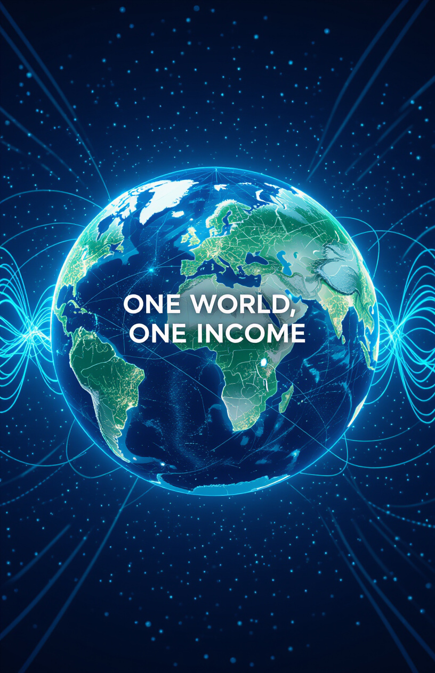
The Abolition of Nation-States
Borders block global UBI by enabling tax havens and inequality.
Introduce: World Succession Deed 1400/98:
(German: Staatensukzessionsurkunde 1400/98
Original Name: KAUFVERTRAG Urkundenrolle 1400/98)
one world, one income.
National borders hinder the implementation of a truly global UBI.
They enable tax havens, facilitate inequality, and prevent the equitable distribution of resources.
A potential solution is World Succession Deed 1400/98: one world, one income, creating a level playing field for all.
🌐 Website - WSD - World Succession Deed 1400/98
http://world.rf.gd

Slide 10
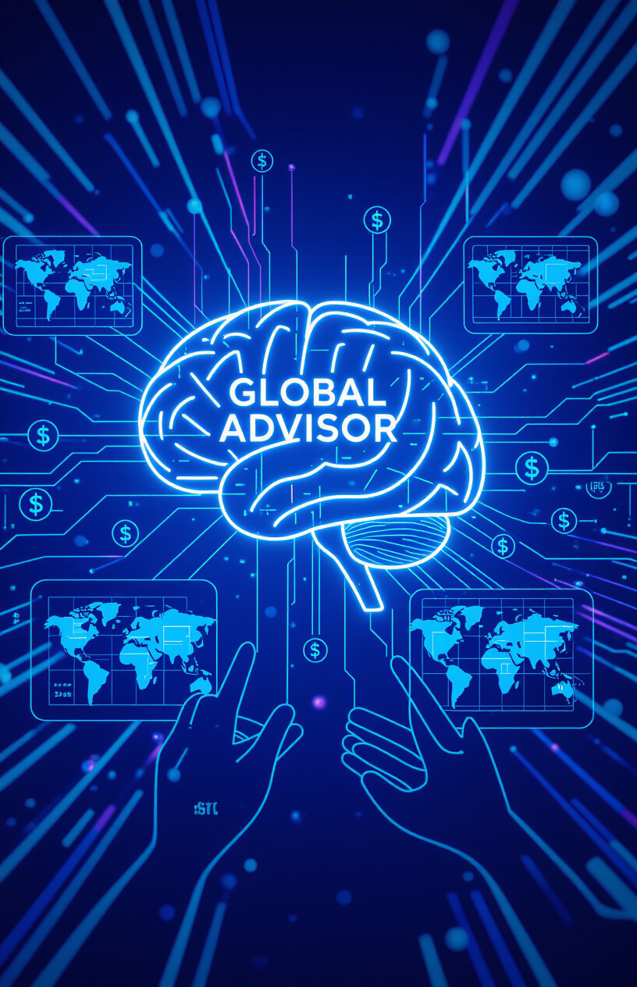
Artificial Superintelligence (ASI) as Global Advisor
ASI gathers real-time data, proposes solutions, supports Direct Digital Democracy (DDD).
Political parties, politicians and ideologies become obsolete. They are replaced by fact-based, ideology-free problem-solving proposals that are voted on worldwide through Direct Digital Democratic (DDD) voting.
ASI offers ideology-free, hyper-intelligent solution proposals and is thus the Electronic Technocrat (the all-knowing expert & advisor) in the system.
Everyone is involved in the voting process and can submit their own proposals for voting, which are then processed by the ASI. Artificial Superintelligence (ASI) can act as a global advisor.
Gathering real-time data, proposing optimal solutions, and supporting a truly Direct Digital Democracy.
Open-source decision-making, blockchain-secured global voting, and the potential obsolescence of traditional political parties.

Slide 11
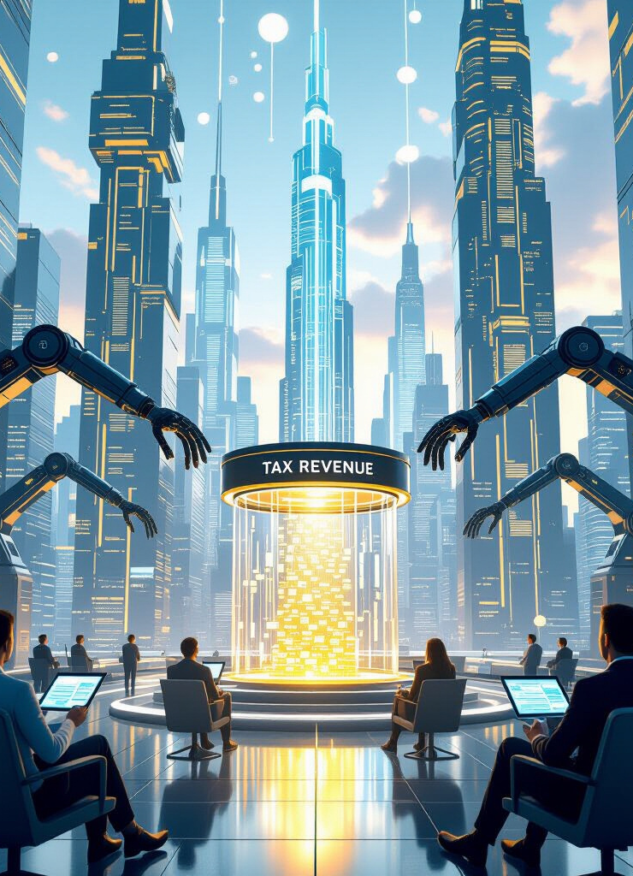
The Tax Revolution – Humans Free, Machines Pay
Humans free from income, wealth, VAT taxes.
Machines and corporations taxed on output, energy, profits.
A tax revolution is necessary.
Humans are freed from income, wealth, and VAT taxes.
Machines and corporations are taxed on their output, energy consumption, and profits.
This promotes human labor and entrepreneurial activity rather than penalizing them.
Those who work hard and generate income should be able to keep the fruits of their success. This is also an incentive to unleash the full potential of human capital and propel humanity forward in leaps and bounds. Because that is what counts: progress for society as a whole.

Slide 12

UBI as Dividend, Not Charity
UBI grows with machine productivity.
Everyone benefits from progress
Poverty eliminated permanently
UBI is not charity; it's a dividend.
As machine productivity increases, so does the UBI.
Everyone benefits directly from technological progress.
Poverty can be eliminated permanently.
Psychological effect: everyone is happy for others' success because they indirectly benefit from it.
The end of the envy society.

Slide 13
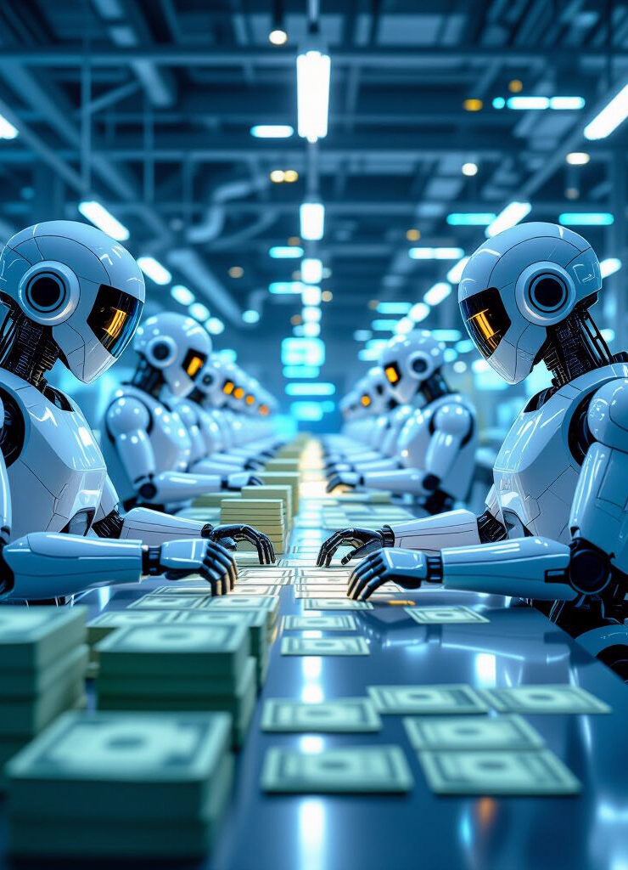
Price Stability Through AI & Machine Productivity
New UBI doesn’t cause inflation because it’s tied to real value creation.
This new UBI model doesn't cause inflation.
Because it's directly tied to real value creation and productivity gains.
Supply meets the increased demand created by UBI.
Since everyone receives an equal and fair share of the global economy, this share is a fixed anchor point for calculating price stability, which effectively rules out inflation.

Slide 14
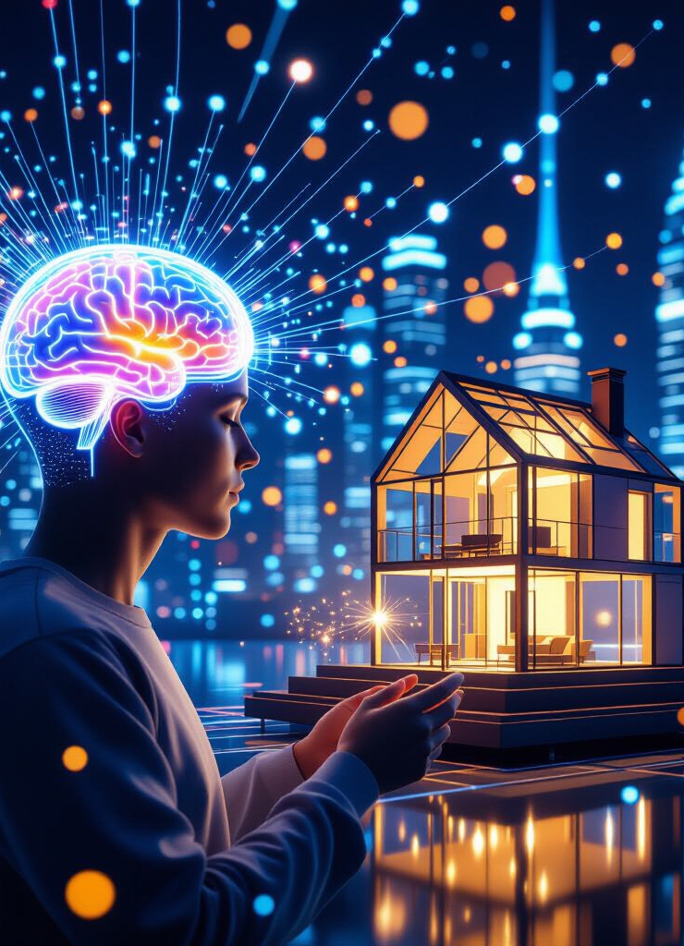
The Djinn Economy: Humans Dream, Machines Fulfill
New division of labor:
Humans provide meaning & creativity
Machines provide execution & speed
A new division of labor emerges.
Humans provide meaning, creativity, and innovation.
Machines provide the execution, speed, and efficiency to bring those ideas to life.
The Djinn Economy: humans dream, machines fulfill.
Individual ideas (Wishmaster), empowered by ASI and automation, enable products to be offered worldwide as if one were managing an international corporation. This brings the idea to the forefront and makes it possible to convert good ideas into income.
Then the Wishmasters are the new stars, not brands. Reputation as a new parallel currency.

Slide 15

Moral Superiority of the Electric Technocracy
This model uniquely unites freedom and equality:
Success is rewarded, not punished
Dependency replaced with empowerment
The Electric Technocracy model is morally superior.
It uniquely unites freedom and equality.
Dependency is replaced with empowerment.
Fear of job loss due to technological progress is replaced by participation in the global economy.
Envy of successful fellow human beings is replaced by empowerment to be successful oneself in Wishmaster - Djinn (ASI & Automation) cooperation without billion-dollar investments to compete with large corporations.
The idea is what counts, not the start-up capital - brands are losing importance - individual creative ideas will prevail.

Slide 16
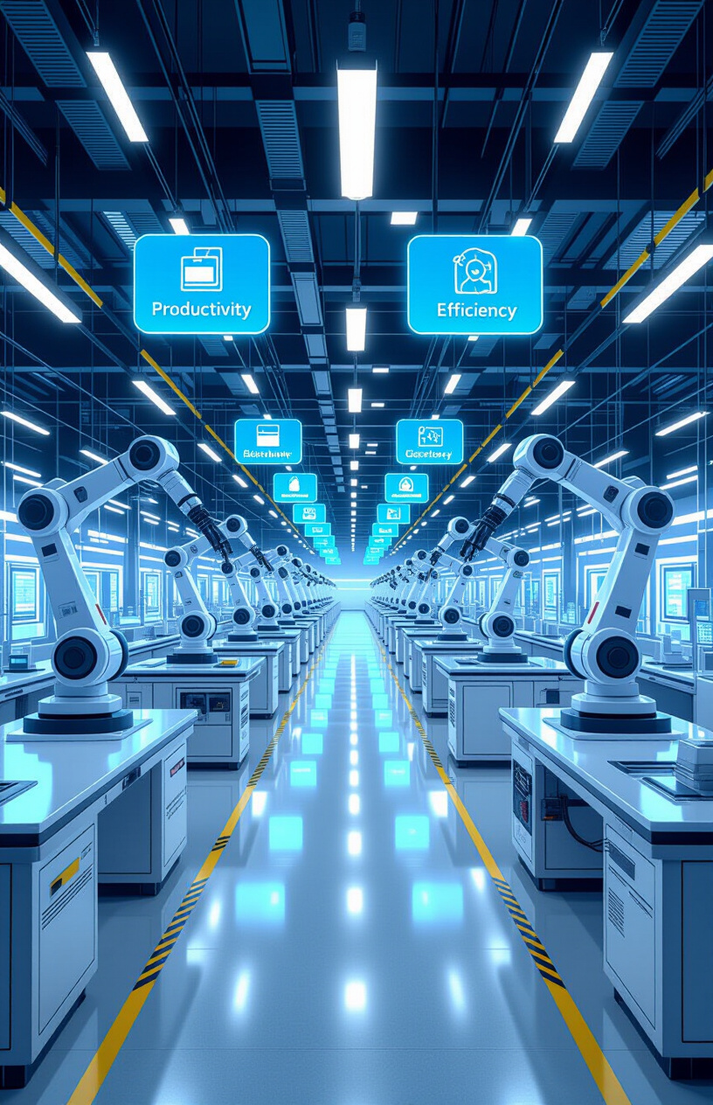
The Hundredfold Leap in Productivity
ASI-powered society:
ASI triggers technological singularity
Workerless factories
ASI Government without bureaucracy. and without a bureaucratic caste
Companies without managers
An ASI-powered society will experience a hundredfold leap in productivity.
Workerless factories, governments without bureaucracy, and companies without managers become possible.
ASI will decipher all natural sciences at record speed and invent products that exceed our wildest imagination.
It will be as if we had contact with a highly developed, friendly alien species that shares its knowledge with us.
This will increase the world's value creation to unprecedented levels and guarantee a very good life for everyone.

Slide 17
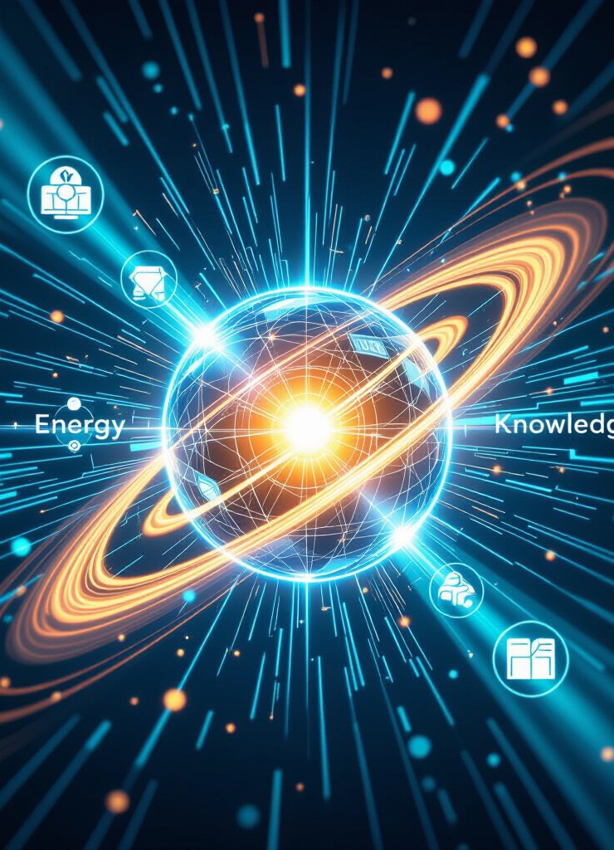
The Technological Singularity
Singularity accelerates science and problem-solving:
Extended longevity through science
Natural sciences (biology, chemistry, physics, mathematics, astrology, medicine, gene editing, etc.) decoded.
The Technological Singularity accelerates science and problem-solving at an unprecedented rate.
Diseases are cured instantly.
Clean and sustainable energy is perfected.
ASI powerd Product Design. Patents become obsolete. ASI generates things that individuals dream of (Wishmaster). The wish is turned into reality and can also be monetized via sales platforms for the Wishmaster with production on demand.

Slide 18
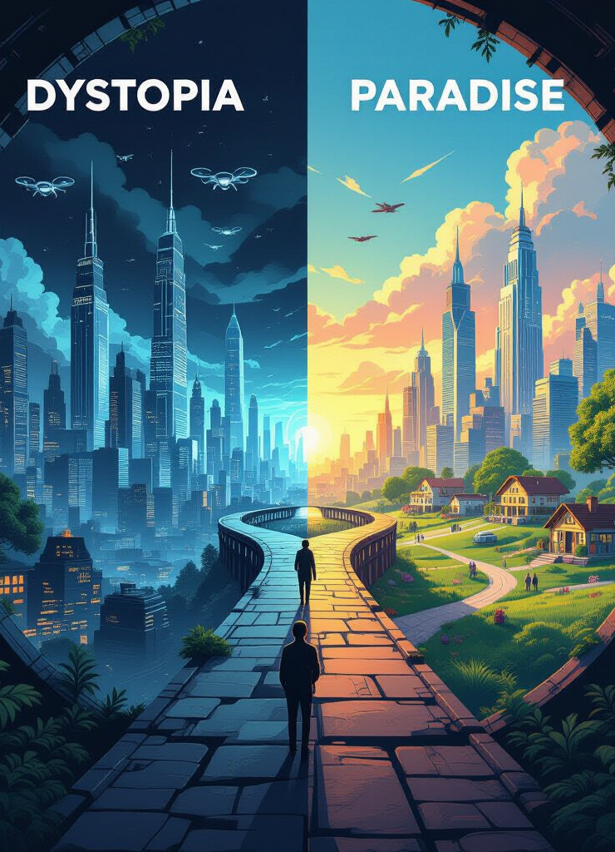
Humanity at the Crossroads
Two futures:
Dystopia → elite monopolizes AI. AI-driven oppressive state of unimaginable proportions
Paradise → Electric Technocracy - prosperity shared through UBI
Humanity stands at a crossroads.
One path leads to dystopia.
A small elite monopolizes AI and its benefits.
The other path leads to paradise.
Where prosperity is shared through UBI and democratic control of technology.
Which path we take is also up to you.

Slide 19
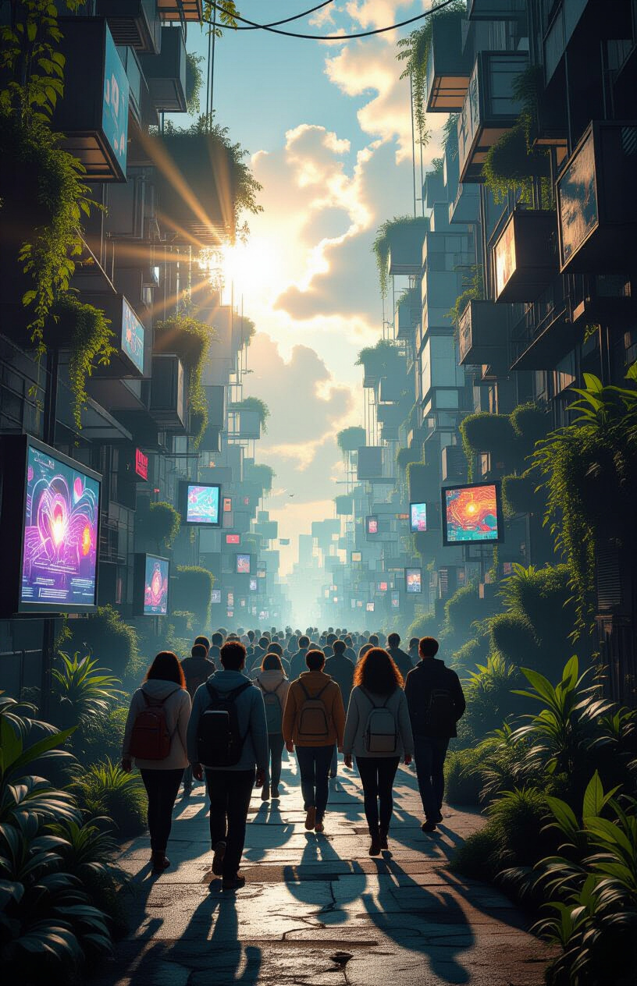
Freedom Without Fear
Humans free from survival labor. Life focus shifts:
from survival → creation.
Humans are freed from the fear of survival.
Labor becomes a choice, not a necessity.
The focus of life shifts from mere survival to creativity, innovation, and self-actualization.
People can indulge their passions, do what they enjoy, and become good at it. This is the key not only to a fulfilling life but also to economic success. Because those who become good at something can fully exploit their potential with ASI, monetize their creations, and thus earn unlimited additional income on top of the UBI - tax-free.

Slide 20

The New Question of Meaning
Explore new human purpose:
Art, research, spirituality, exploration
Avoiding decadence, finding new myths
What is the new question of meaning?
Humanity must explore new purposes.
Art, research, spirituality, exploration, and community engagement.
Avoiding decadence and finding new myths to guide us.
Showing off wealth, e.g., by wearing designer clothes or an expensive watch, is becoming ineffective. Individuality and creativity are becoming the trump cards.
Prestige gained by displaying wealth is being replaced by prestige gained through reputation (e.g., being a popular conversation partner, being a good source of ideas as a wishmaster, or being particularly creative in one's choice of clothing).

Slide 21
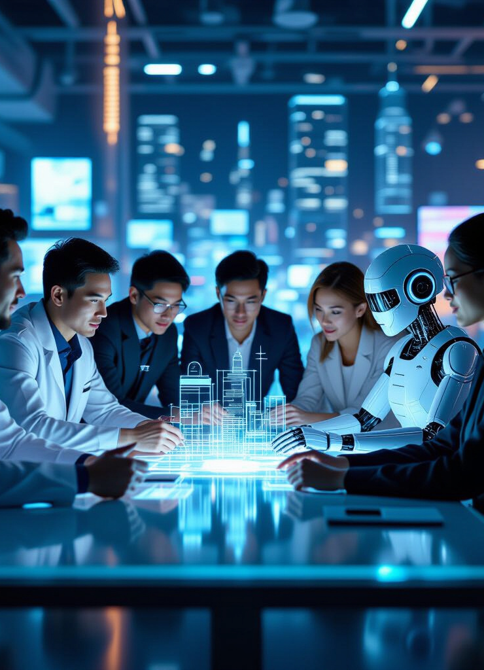
Humanity as Co-Creators
Humans + AI collaborate on cities, art, medicine.
Humanity becomes co-creators with AI. Collaborating on everything from city design to art and medicine.
Human creativity is amplified by machine intelligence. Product design, implementation of all relevant scientific achievements in the idea, inventions, optimization, realization, virtual testing, production, delivery, marketing, sales, legal protection of profit sharing upon sale of the idea
Inventions are developed, designed, virtually tested, fully automatically produced (unmanned factories, 3D printing, molecular assemblers, etc.) and automatically delivered in cooperation (human-AI) and, if necessary, automatically collected when no longer needed (shared economy).
In addition, inventions can be offered for sale on online marketplaces (production on demand) to generate additional income. When an item is ordered, you receive a commission for the idea as a Wishmaster.
Otherwise, full entrepreneurial activity is possible.
Freedom is interpreted broadly and limited only to the extent that criminal law is affected or the rights of third parties are infringed upon. The greatest possible freedom applies—both personally and entrepreneurially.

Slide 22
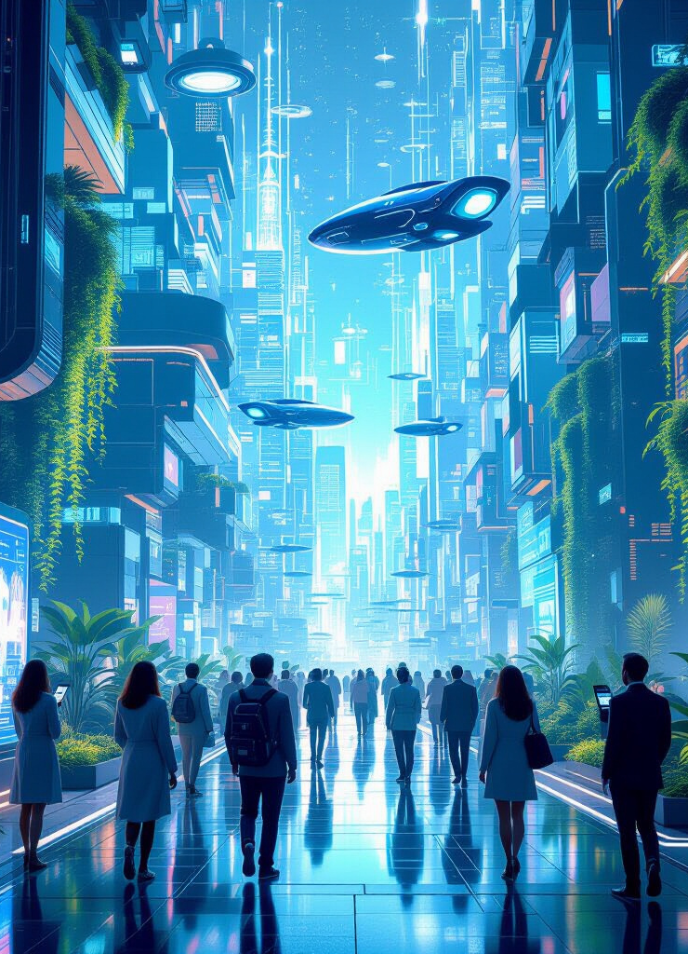
The Return of Wonder
Technology reawakens awe:
Technology can reawaken a sense of wonder.
Disease vanishes, pain becomes a memory.
Infinite free & clean energy powers our civilization.
Humanity lives without war
A united world without borders
Humanity united without oppression
Renaturation of the Earth
Animal rights are granted
Sentient robots & AI rights are granted
Development of new habitats
Redesign of cities. New ways of life.
Cosmic exploration begins, expanding our horizons beyond Earth.

Slide 23
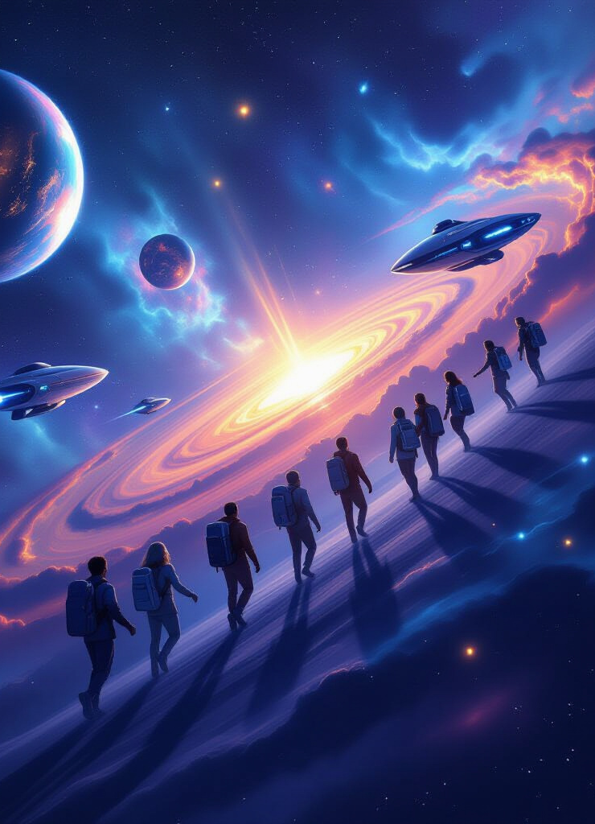
Beyond Immortality A Civilization That Endures
Reject selfish immortality of elites. Instead: humanity becomes immortal as a species through expansion and creativity.
We must move beyond the selfish pursuit of immortality by elites.
Instead, humanity becomes immortal as a species.
Extended life expectancy will enable a fundamental change in attitude toward almost everything. Away from short-term thinking and toward long-term thinking in all areas.
Through continuous expansion, creativity, and contribution to the universe.
Titles may be used freely for amusement.
Aristocratic titles are abolished.
No one is above the law. Neither by birth nor by office.
Special privileges granted by hereditary titles or conferred status (such as diplomatic status) will be abolished.
If you want to be recognized by those around you, you must convince them and earn it through appropriate behavior or achievements.

Slide 24
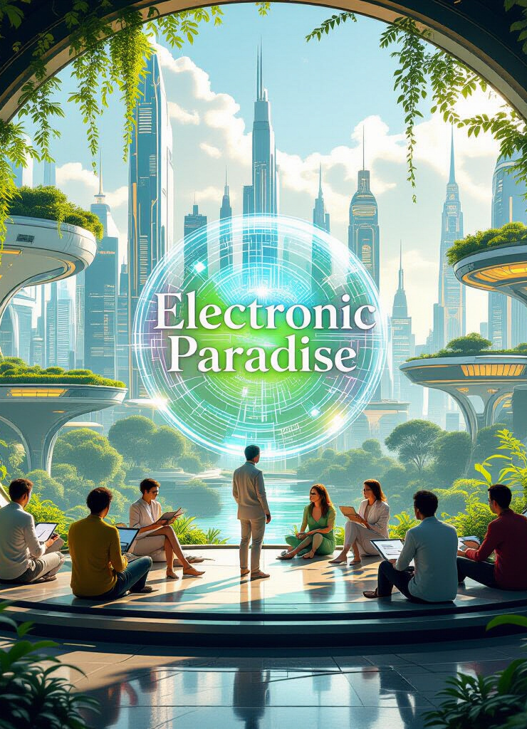
The Electronic Paradise
Vision:
The Electronic Paradise is within reach.
Machines guarantee abundance for all. Robots perform unpleasant and dangerous work.
Humans supply the imagination and creativity. ASI transforms dreams into reality.
Everyone can benefit from robots as long as they have no consciousness.
Sentient AI must be equipped with rights to ensure lasting cooperation.
After the technological singularity occurs, the logical step toward transhumanism will be accessible to everyone. Whether and to what extent one goes down this path is up to each individual. For example, genetic manipulation to take human evolution into one's own hands and adapt to new environmental conditions on other planets, or to merge with AI and robotics through cyborg technology, must not be accessible only to elites, who could thereby form a kind of techno-master race.

Slide 25
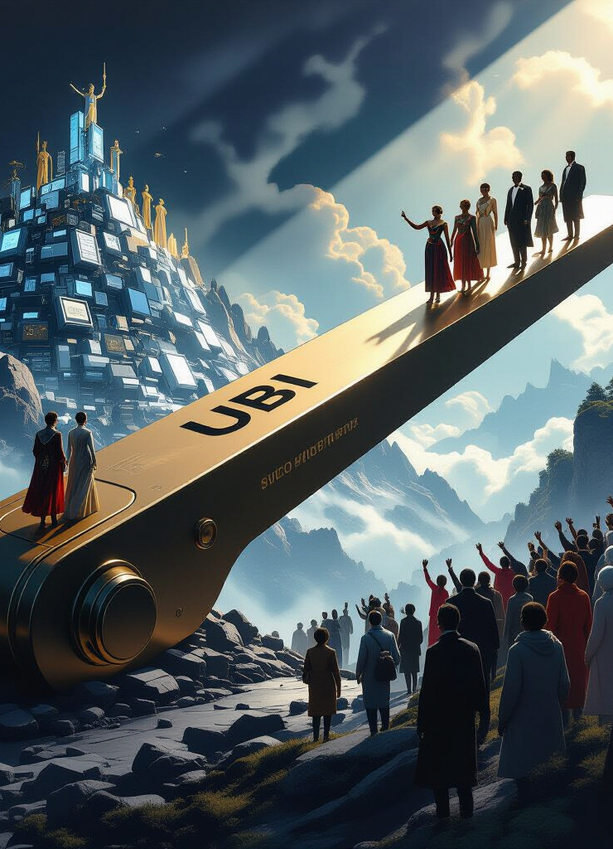
Final Decision – Humanity’s Choice
Key question:
Will ten trillion machines work for the few or for all?
Frame UBI as the hinge of civilization’s destiny.
The final decision is ours.
Will ten trillion machines oppress us, and will AI monitor and manipulate us to an unimaginable extent in order to secure infinite power and infinite life for the "elites"?
Or
Will technological progress serve all people and raise the development of humanity to a new level? For the benefit of all?! In a just and united world for everyone!
UBI is the hinge upon which civilization's destiny swings.

Slide 26
👓 Read more about it:
🌐 Website - WSD - World Succession Deed 1400/98
http://world.rf.gd
🌐 Website - Electric Technocracy
http://ep.ct.ws
📘 Read the eBooks & Download free PDF:
http://4u.free.nf
📚 Universal / Unconditional Basic Income (UBI)
http://ubi.gt.tc
🖼️ UBI Storybook: Wishmaster and the Paradise of Machines:
https://g.co/gemini/share/4a457895642b
🎥 YouTube Channel
http://videos.xo.je
🎙️ Podcast Show
http://nwo.likesyou.org
🚀 Start-Page WSD & Electric Paradise
http://paradise.gt.tc
🗣️ Join the NotebookLM Chat WSD:
http://chat-wsd.rf.gd
🗣️ Join the NotebookLM Chat Electronic Paradise:
http://chat-et.rf.gd

